Slide 1
Industry Update

Slide 2
Key Trends and Outlook
As fraud losses increase, the networks are requiring migration towards EMV following trend seen in other parts of the world:
  Discover reported fraud losses increased 70% in 2012 compared to 2010 figures
  Card networks announced they will require terminals to include EMV by late 2015. Credit card thief's will be motivated to use stolen card data more quickly before it becomes much harder to use with new terminals which may cause fraud rates to increase in the short term
  EMV enabled cards are beginning to gain traction. BAC, US Bank, and Chase have all recently announced new EMV chip card products
Costs of the Durbin Amendment to the Dodd Frank law are widespread and continue to impact customer checking/debit account terms with future legal action expected to further impact credit card terms:
  State Employees CU; one of only three credit unions restricted by the Durbin Amendment ,calculated the cost to their members at $40mm in 2012
  Fees on non-interest checking accounts increased 23% in 2012
  The Durbin Amendment has saved retailers over $6.5B since 2011, however, a majority of retailers have still raised prices (63%)
  A Federal court is now reviewing a July 2012 settlement that opens the door for retailers to begin adding a surcharge for customers who use credit cards, further increasing retailer leverage
Mobile wallets are unlikely to take off in 2013:
  Retailers will need to invest in new POS terminals with more capabilities to support the promise of the mobile wallet
  The multitude of mobile wallet providers makes it difficult for any mobile payment option to gain traction. Market leaders like Google are already looking at adding traditional cards to their product offerings
  Providers have yet to effectively safeguard their devices against cyber criminals
Personal finance is likely to become more consumer friendly:
  As CFPB matures, its focus is expanding beyond the credit card and mortgage industries into credit bureaus and debt collectors, with checking accounts and prepaid cards not far behind
  Secured credit cards are a safe bet for all parties, those with bad credit flocked toward them in 2012 after many years of limited interest with the rise in debit cards as an alternative
  Issuer rewards offerings continue to become more attractive to consumers with new products such as Discover’s It, Bank of America’s Travel Rewards and Pen Fed’s Cash rewards all raising the bar for both branded and affinity products.
Sources: American Banker, Payment Source, creditcards.com, cardhub.com, Huffington Post, Reuters, Cardline, Nerd Wallet, Business Insider

Slide 3
Industry Headlines
While national banks and credit issuers continue to struggle with consumer perceptions, interest in credit has increased and issuers are more aggressively competing for new customers especially with excellent credit, but are starting to consider prospects with less than perfect credit.
Reward offers are rising while introductory offers have peaked:
  The average initial cash-based bonus is 11.19% higher than Q3 2012 and 14.88% higher than Q4 2011
  The average points/miles-based bonus increased 9.14% from Q3 2012 and 12.10% from Q4 2011
  The length of the average 0% term has remained largely unchanged in Q3 and Q4 2012, indicating the value of these offers has plateaued
Consumer credit increases and penalty APRs remain high:
  November 2012 shows seasonally adjusted consumer credit increase of 7%
  Revolving credit increased at an annual rate of 1% while non-revolving credit increased at an annual rate of 9.5%
  The average penalty APR of 28.23% remains unchanged from Q3 2012
Fees and consumer surcharge:
  Retailers can now levy a surcharge on credit using consumers that can reach as high as 4%
  10 states have prohibited credit card surcharges
  Foreign transaction fees have fallen more than 7% since last year, but the trend is beginning to flatten out as the Q4 average of 2.25% represents a 0.90% increase over Q3
Reflection of stability in consumer complaints, rates rise marginally, and prepaid cards boom:
  CFPB reports APR-related complaints fell 20% in Q4, while those related to credit reports increased more than 50%
  Across the board interest rates for unsecured cards where higher in Q4 2012 than the previous quarter and prior year
  Projections show 43.9% increase in amount loaded onto prepaid cards from 2011 to 2012
Sources: American Banker, Payment Source, creditcards.com, cardhub.com, Huffington Post, Reuters, Cardline, Bloomberg News, AP, Washington Post, NY Times

Slide 4
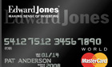

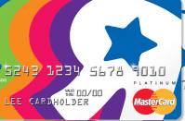
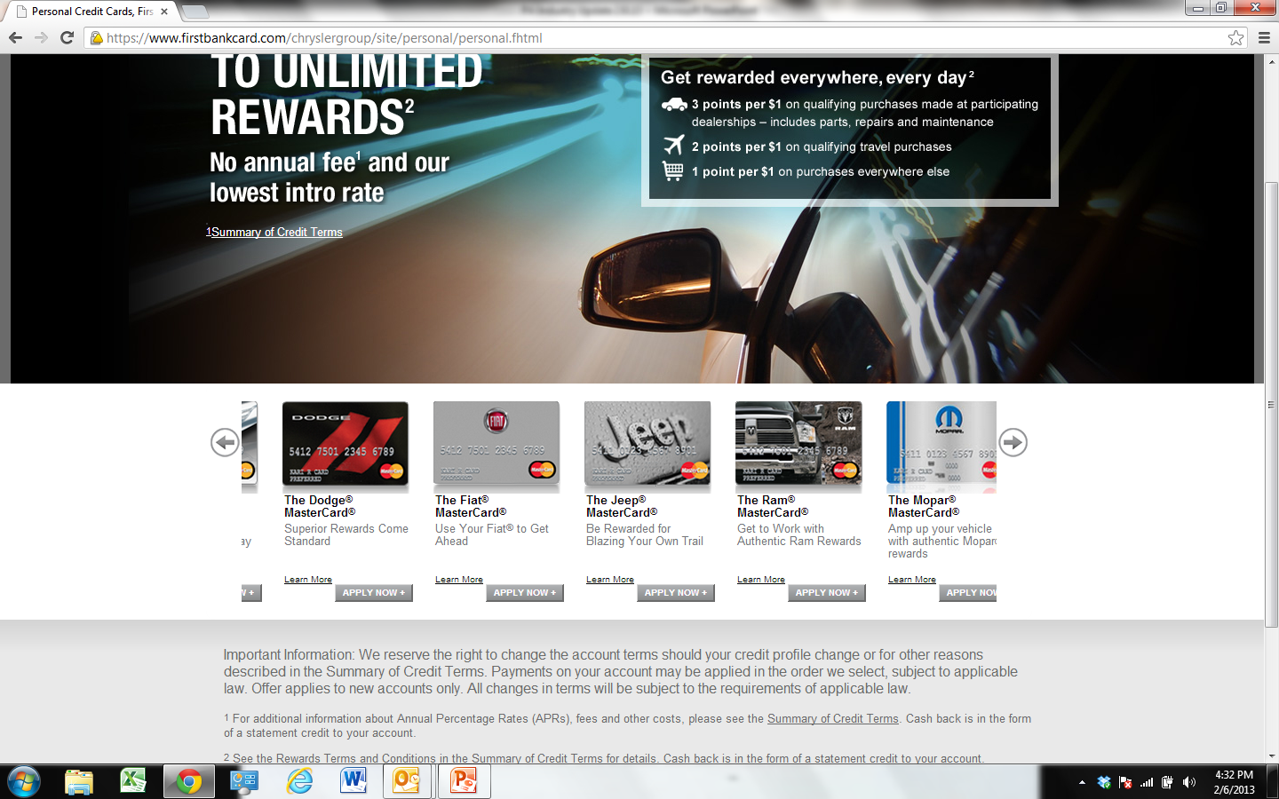


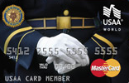
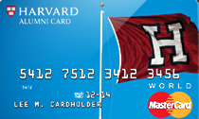

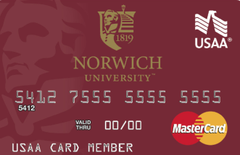
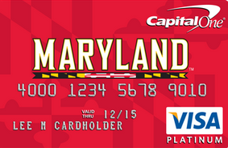
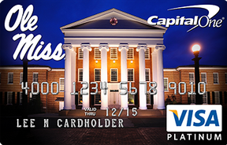
2012-2013- Notable Deals
Cobrand Deals:
Affinity Deals:
Program | Edward Jones | La Quinta | True Value | Toys”R”Us | Chrysler Group LLC | IndyCar
Prior Issuer | Bank of America | Chase |  | Chase | Bank of America | Bank of America
New Issuer | US Bank | FNBO | Discover | GE Capital | FNBO | FNBO
Program | American Legion | Harvard University | Ducks Unlimited | Norwich University | University of Maryland | Ole Miss
Prior Issuer | Bank of America | Barclaycard | Bank of America | Bank of America | Chase | Bank of America
New Issuer | USAA | Harvard CU | Discover | USAA | Capital One | Capital One

Slide 5
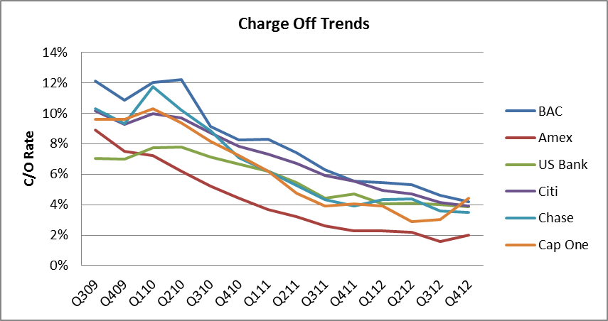
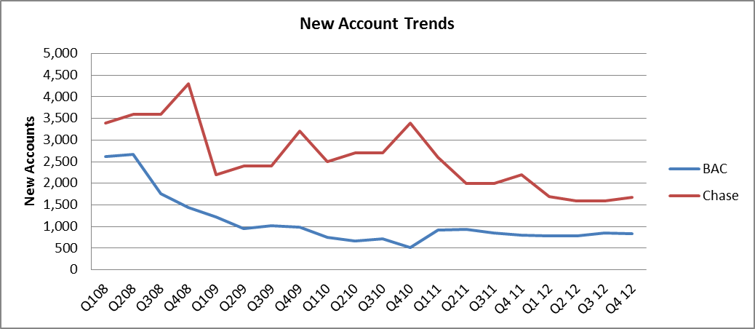
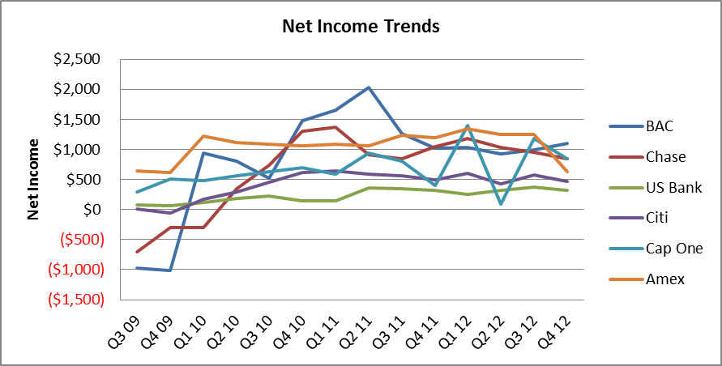
Issuer profitability continues to improve
Charge-off rates have leveled off in Q2-Q4 2012 after declining steadily for over 2 years. Losses have returned to near historical levels after a large spike during the 2008-2009 recession.
Net income has improved industry wide over the past 18 months as loan loss reserves have been released. Currently Net Income for most issuers remains flat in 2012.
While profitability has improved significantly, new account acquisition remains a challenge. Chase acquisition is 50% below pre-recession levels bank wide and has remained steady through Q3 2012.
Source: Company financial reports
Source: Company financial reports
Source: Issuer financial reports
5

Slide 6
Consumer Credit Trend
Although total debt has increased since the bottom of the recession, revolving debt has remained well below pre-recession levels.
  Revolving Debt remains relatively flat over the past two years, 15%-20% below YE 2008 and has not increased even though issuer appetite for loan balances is improving.
  After declining slightly in 2009-2010, total debt has rebounded in 2011 and 2012. We expect this trend to continue, especially as the housing market begins to rebound.
Sources: Federal Reserve Board of New York

Slide 7
Affinity Sector Headlines
BAC Affinity Strategy:
BAC is looking to reduce the overall number of affinity programs in their portfolio from over 5,000 to <500.
Programs are being placed in three buckets- on strategy (larger national brands with growth potential), non-strategic but with potential, and non-strategic.
Many programs have already been deprioritized and are now being serviced by the Group Incentive Program (GIP) portal team
Overall Landscape:
The affinity business continues to contract as more programs are not renewed and other programs convert from large guarantees to earned compensation
A few select programs have been able to identify alternative issuers at compensation rates >60% of their previous guarantee level, however, these programs represent a small minority of the programs that renewed in 2010 and 2011 and have required large increases in partner investment
Interest from regional issuers and credit unions continues to increase as the entry barriers in the space have been reduced
Partners that have a movable portfolio of decent size may find more interested issuers.
Growing players in the space:
Capital One entered the affinity segment and now has over 30 professional society, collegiate and cause partnerships. Recent acquisitions of HSBC and ING portfolios have stretched bandwidth and interest has lessened.
Select credit unions such as Pentagon Federal Credit Union (PFCU) are actively bidding on affinity programs outside the military space. Recently Pen Fed announced a partnership with AMA
Select regional banks have entered relationships, mainly with colleges and universities with strong footprint overlaps.

